Slide 1
Corso di laurea in Informatica Programmazione WEB
Regular expressions
a.a 2017-2018

Slide 2
Regular Expressions
A regular expression is an object that describes a pattern of characters.
Regular expressions are used to perform pattern-matching and "search-and-replace" functions on text.

Slide 3
Regular Expressions: Overview
You specify a regexp with /pattern/
Not with a string as in java and many other languages
Most special characters same as in java/unix/perl
^, $, . – Beginning, end of string, any one char
\ – Escape what would otherwise be a special character
*, +, ? – 0 or more, 1 or more, 0 or 1 occurrences
{N}, {n,} – exactly n, n or more occurrences
[] – Grouping
\s, \S – whitespace, non-whitespace
\W, \W – word char (letter or number), non-word char
Modifiers
/Pattern/g – do global matching (find all matches, not just first one)
/Pattern/i – do case-insensitive matching
/Pattern/m – do multiline matching

Slide 4
String Methods that Use Regular Expressions
Replace
Replaces all places that match the regular expression with a replacement string
"Axbxxcxxxd".Replace(/x+/g, "q") → "aqbqcqd"
Match
Returns array of parts of the string that match the regular expression
"Axbxxcxxxd".Match(/x+/g) → ["x", "xx", "xxx"]
Split
Returns array of all parts of the string that are in between the regular expressions
"Axbxxcxxxd".Split(/x+/) → ["a", "b", "c", "d"]
Search
Returns the position of the first place that matches the regular expression
"Axbxxcxxxd".Search(/x+/) → 1

Slide 5
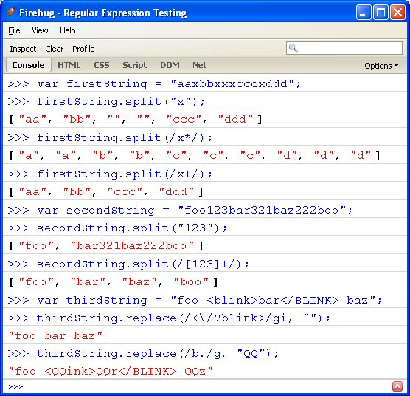
Regular Expression: Examples

Slide 6
Example1: username
JavaScript code for validating user name
view plaincopy to clipboardprint?
function allLetter(uname)
{
var letters = /^[A-Za-z]+$/;
if(uname.value.match(letters))
{
return true;
}
else
{
alert('Username must have alphabet characters only');
uname.focus();
Return false;
}
}

Slide 7
Example2: useraddress
Function alphanumeric(uadd)
{
var letters = /^[0-9a-zA-Z]+$/;
if(uadd.value.match(letters))
{
return true;
}
else
{
alert('User address must have alphanumeric characters only');
uadd.focus();
return false;
}
}

Slide 8
Example3: JavaScript code for validating email format
function ValidateEmail(uemail)
{
var mailformat = /^\w+([\.-]?\w+)*@\w+([\.-]?\w+)*(\.\w{2,3})+$/;
if(uemail.value.match(mailformat))
{
return true;
}
else
{
alert("You have entered an invalid email address!");
uemail.focus();
return false;
}
}

Slide 9
Example 4: Phone Number validation (1)
At first we validate a phone number of 10 digits with no comma, no spaces, no punctuation and there will be no + sign in front the number. Simply the validation will remove all non-digits and permit only phone numbers with 10 digits.
function phonenumber(inputtxt)
{
var phoneno = /^\d{10}$/;
if((inputtxt.value.match(phoneno))
{
return true;
}
else
{
alert("message");
return false;
}
}

Slide 10
Example 4: Phone Number validation (2)
To valid a phone number like
XXX-XXX-XXXX
XXX.XXX.XXXX
XXX XXX XXXX
use the following code.
function phonenumber(inputtxt)
{
var phoneno = /^\(([0-9]{3})\)?[-. ] ([0-9]{3})?[-. ]([0-9]{4})$/;
if((inputtxt.value.match(phoneno))
{
return true;
}
else
{
alert("message");
return false;
}
}

Slide 11
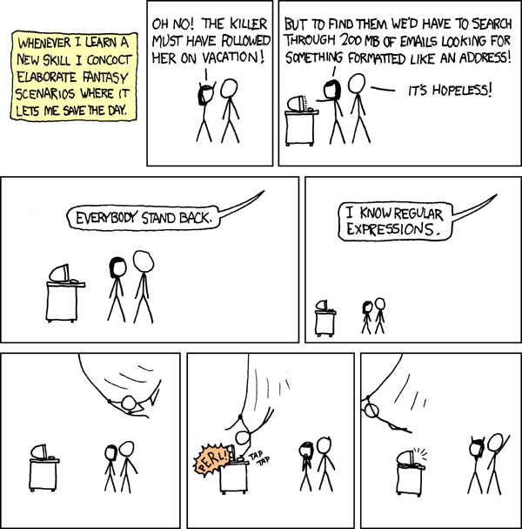
More Information on Regular Expressions
Online API references given earlier (see regexp class)
Http://www.W3schools.Com/jsref/jsref_obj_regexp.Asp
Http://www.Devguru.Com/technologies/ecmascript/quickref/regexp.Html
Javascript regular expression tutorials
Http://www.Evolt.Org/article/ regular_expressions_in_ javascript/17/36435/
Http://www.Javascriptkit.Com/ javatutors/re.Shtml
From Randall Munroe and xkcd.com

